Slide 1
DEVELOPING SUSTAINABLE CITIES
Establishing a National Framework – The Trinidad and Tobago Experience
Sustainable Cities – December 1 – 5 2014
Module 1
Marie Hinds

Slide 2
OBJECTIVE
Understand and appreciate the components and goals of sustainable urban/city development
Explore, evaluate the Trinidad and Tobago experience in the context of the above

Slide 3
ASSUMPTIONS
Development must be consistent with the higher order national goals and priorities and this consideration must influence the structure and approach to planning.
The planning process must provide for sustainability of development initiatives
Sustainable urban development is NOT the sole domain of town and country planners

Slide 4
SUSTAINABLE URBAN DEVELOPMENT

Slide 5
GOALS OF SUSTAINABLE URBAN DEVELOPMENT
ENVIRONMENTAL DIMENSIONS
ECONOMIC DIMENSIONS
SOCIAL DIMENSIONS
INSTITUTIONAL DIMENSIONS
Global Report on Human Settlements (UN‐HABITAT, 2009)

Slide 6
ENVIRONMENTAL
Reducing greenhouse gas emissions and implementing serious climate change mitigation and adaptation actions
Minimizing urban sprawl and developing more compact towns and cities served by public transport
Sensibly using and conserving non‐renewable resources
Reducing energy use and waste produced per unit of output or consumption
Recycling or disposing of waste produced in ways that do not damage the wider environment
Reducing the ecological footprint of towns and cities

Slide 7
ECONOMIC DIMENSIONS
Reliable infrastructure and services, including for water supply, waste management, transport and communications, and energy supply
Affordable access to land or premises in appropriate locations with secure tenure
Financial institutions and markets capable of mobilizing investment and credit
A healthy educated workforce with appropriate skills
An enforceable legal system that ensures competition, accountability and property rights
Appropriate and adequately resourced regulatory frameworks which define and enforce non-disciplinary, locally appropriate minimum standards for the provision of safe and healthy workplaces and the treatment and handling of waste emissions

Slide 8
SOCIAL DIMENSIONS
Promoting equal access to, and fair and equitable provision of, services
Advancing social integration by prohibiting discrimination and offering opportunities and
Physical space to encourage positive interactions
Assuring gender and disability sensitive planning and management
Preventing, reducing and eliminating violence and crime, including its causes

Slide 9
INSTITUTIONAL DIMENSIONS
Political will and support in the delivery of sustainable visions
Transparent administrative structures and processes
Adequate and sustained institutional capacities
Appropriate supporting legal frameworks
Sustained stakeholder involvement
Adequate sustained coordination between concerned government bodies, and among government bodies, community groups and private sector stakeholders
Relevant and effective regulations for the sustained management and revenue generation of urban development services

Slide 10
THE TRINIDAD AND TOBAGO EXPERIENCE

Slide 11
Translating the goals of sustainable development into the urban sector is complex. The complexity and interdependence of the issues and challenges related to sustainable development can only be effectively addressed if a strategic framework for sustainable development is employed in urban planning.

Slide 12
STRATEGIC FRAMEWORK FOR SUSTAINABLE DEVELOPMENT
• Address the problem of climate change and reducing the carbon footprint of cities;
• Incorporate efforts to integrate the “green” and “brown” agendas;
• Effectively link urban land use planning, urban development and infrastructure planning; and
• Undertake planning in peri‐urban areas and at the regional level

Slide 13
NPDP – A NATIONAL SPATIAL FRAMEWORK
The 1984 NPDP provided detailed landland-use zones and allocations, for application across Trinidad and Tobago.
That approach was logical at a time when most planning decisions were being made at national government level.
It was indicative of political appreciation that economic plans (5 year development plans) necessitated a land use context

Slide 14
NPDP – A NATIONAL SPATIAL FRAMEWORK
The NPDP was based on a strategy which sought to:
promote a more balanced allocation of activities throughout the national territory by means of chosen growth points, based on development potential
Consolidate existing urban centres.
The objective of the strategy was to:
Reduce problems of congestion in the urban centres and
Provide for a more equitable quality of life in all regions

Slide 15
DISPERSED CONCENTRATION
The preferred scenario was one which attempted to strike a balance between concentration and dispersal by combining the advantages of the two other development strategies.
Harness the economies inherent in a settlement pattern of concentration while promoting development throughout the country
To consolidate existing urban centres and expand into areas of high potential thus stimulating growth without increasing congestion costs and disparity between the present urban and rural regions.

Slide 16
METHODOLOGY
Contain and rationalize built development in existing urbanized areas
Develop Growth Centres in peripheral areas where there are complexes of opportunities
Growth would be stimulated at selected points through the promotion of economic expansion by
Commitment of resources to the development of infrastructure
Dispersal of public sector employment opportunities
Combined with institutional support and financial incentives

Slide 17
In the Capital and San Fernando Regions urban expansion would be continued to those areas in which a commitment to built development had already been made. Any further growth would result from Infilling and intensification of the then urban area.
Growth poles would be developed at Couva, Sangre Grande, Mayaro/Galeota and Point Fortin to accommodate the bulk of new growth.
The growth pole at Sangre grande would both siphon off activity attracted toward the Capital Region, and provide a focus for development of the agricultural and mineral resources in its hinterland.
The growth pole at Mayaro/Galeota would stimulate exploitation of the high potential of the agricultural, fisheries, resort and mining opportunities in the South East.
The growth pole at Point Fortin would act as a centre for the development of the complexes of potential on the south west peninsula

Slide 18
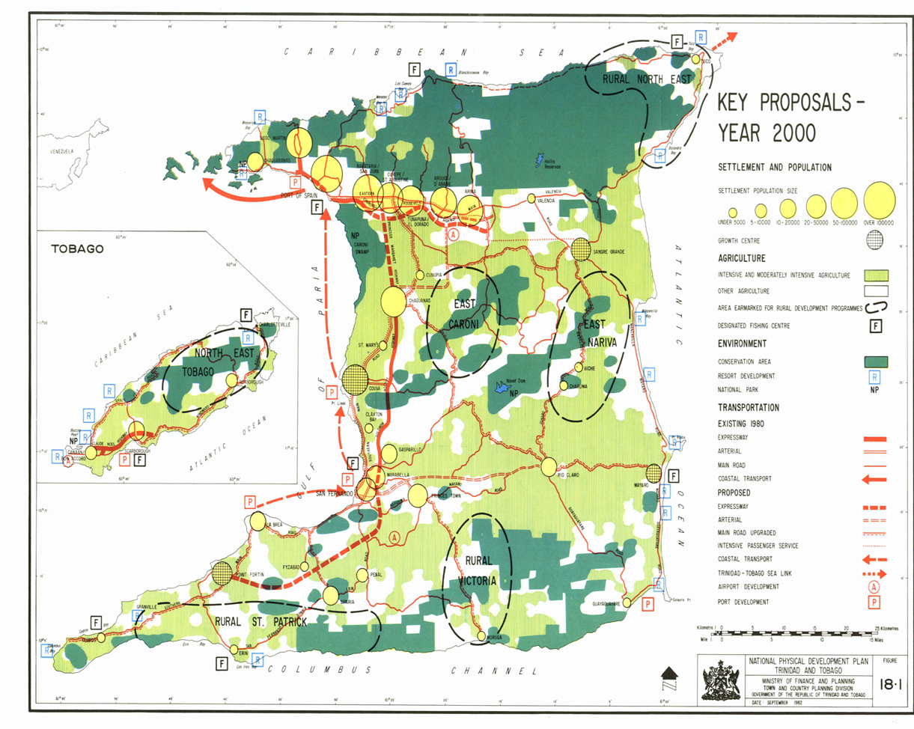

Slide 19
Successful implementation of this strategy required a positive effort on the part of public authorities to foster growth in the selected areas by provision of adequate infrastructure for development, programmes of grants and concessions to firms locating in the specified areas and decentralization of public sector employment to the growth poles.

Slide 20
POPULATION AND SETTLEMENT PATTERNS

Slide 21
 | Population 2011 | Percentage | Population 2000 | Percentage | Increase/Decrease | Percentage
Trinidad | 1,267,889 | 95.7 | 1,208,282 | 95.7 | 59,607 |  | 4.9
City of Port-of-Spain | 36,963 | 2.8 | 49,031 | 3.9 | -12,068 |  | -24.6
City of San Fernando | 50,208 | 3.8 | 55419 | 4.4 | -5,211 |  | -9.4
Borough of Arima | 33,807 | 2.6 | 32,278 | 2.6 | 1,529 |  | 4.7
Borough of Chaguanas | 84,216 | 6.4 | 67,433 | 5.3 | 16,783 |  | 24.9
Borough of Point Fortin | 20,331 | 1.5 | 19,056 | 1.5 | 1,275 |  | 6.7
Diego Martin | 101,703 | 7.7 | 105,720 | 8.4 | -4,017 |  | -3.8
San Juan/Laventille | 155,606 | 11.8 | 157,295 | 12.5 | -1,689 |  | -1.1
Tunapuna/Piarco | 211,741 | 16.0 | 203,975 | 16.2 | 7,766 |  | 3.8
Couva/Tabaquite/Talparo | 185,243 | 14.0 | 162,779 | 12.9 | 22,464 |  | 13.8
Mayaro/Rio Claro | 34,846 | 2.6 | 33,480 | 2.6 | 1,366 |  | 4.1
Sangre Grande | 74,546 | 5.6 | 64,343 | 5.1 | 10,203 |  | 15.9
Princes Town | 101,134 | 7.6 | 91,947 | 7.3 | 9,187 |  | 10.0
Penal/Debe | 91,294 | 6.9 | 83,609 | 6.6 | 7,685 |  | 9.2
Siparia | 86,251 | 6.5 | 81,917 | 6.5 | 4,334 |  | 5.3

Slide 22
 | Population 2011 | Percentage | Population 2000 | Percentage | Increase/Decrease | Percentage
Tobago | 56,810 | 4.3 | 54,084 | 4.3 | 2,726 | 5.0
St. George | 6,220 | 0.5 | 5,364 | 0.4 | 856 | 16.0
St. Mary | 2,988 | 0.2 | 2,965 | 0.2 | 23 | 0.8
St. Andrew | 16,209 | 1.2 | 15,830 | 1.3 | 379 | 2.4
St. Patrick | 14,733 | 1.1 | 14,011 | 1.1 | 722 | 5.2
St. David | 8,134 | 0.6 | 7,504 | 0.6 | 630 | 8.4
St. Paul | 5,490 | 0.4 | 5,412 | 0.4 | 78 | 1.4
St. John | 3,036 | 0.2 | 2,998 | 0.2 | 38 | 1.3

Slide 23
POPULATION AND SETTLEMENT PATTERNS - DENSITY
• Overall, the density of Trinidad and Tobago is 258 persons per square kilometre (p/sq km), a slight increase over the 2000 density of 246 p/sq km;
• The density in Trinidad is 263 p/sq km, slightly higher than the national density, while density in Tobago is only 189 p/sq km;
• At the regional level, densities are highest in the cities and boroughs, ranging from 3,080 p/sq km in Port of Spain to 813 p/sq km in Point Fortin. Densities in the other regions fall below that range. Although Port of Spain has the highest density in the country, the reduction in density was significant between 2000 and 2011 because of loss of population;

Slide 24
POPULATION AND SETTLEMENT PATTERNS - DENSITY
Consistent with the population distribution pattern, densities are generally much higher in the western regions of Trinidad than in the eastern regions of Sangre Grande and Mayaro/Rio Claro where densities are as low as 80 p/sq km and 43 p/sq km, respectively. These two eastern regions cover about one-third of the national territory but accommodate only eight (8) percent of the population; and
In Tobago, 2011 densities are highest in the parishes of St. Patrick and St. Andrew and the pattern is similar to 2000.

Slide 25
Administrative Area | Population 2000 |  | % area pop/T'dadpop | Population 2011 |  | % area pop/T'dad pop | Area in Km² |  | 2011 Density per Km² | 2000 Density per Km²
Trinidad |  | 1208,282 |  |  | 1267,889 | 4,827 |  | 263 |  |  | 250
Port of Spain | 49,031 |  | 4.06 | 36,963 |  | 2.92 | 12 |  | 3080 | 4086
Diego Martin | 105,720 |  | 8.75 | 101,703 |  | 8.02 | 126 |  | 807 | 839
San Juan /Laventille | 157,295 |  | 13.02 | 155,606 |  | 12.27 | 239 |  | 651 | 658
Tunapuna/Piarco | 203,975 |  | 16.88 | 211,741 |  | 16.70 | 510 |  | 415 | 400
516,021 |  |  | 42.71 506,013 |  |  | 39.91
Arima Borough | 32,278 |  | 2.67 | 33,807 |  | 2.67 | 12 |  | 2817 | 2690
East-West Corridor | 548,299 |  | 45.38 | 539,820 |  | 42.58
Chaguanas Borough | 67,433 |  | 5.58 | 84,216 |  | 6.64 | 59 |  | 1427 | 1143
Couva/Tabaquite/Talparo | 162,779 |  | 13.47 | 185,243 |  | 14.61 | 723 |  | 256 | 225
230,212 |  |  | 18.16 269,459 |  |  | 21.25
San Fernando | 55,419 |  | 4.59 | 50,208 |  | 3.96 | 19 |  | 2643 | 2917
North-South Corridor | 285,631 |  | 22.53 | 319,667 |  | 25.21
Mayaro/Rio Claro | 33,480 |  | 2.77 | 34,846 |  | 2.75 | 814 |  | 43 | 41
Sangre Grande | 64,343 |  | 5.33 | 74,546 |  | 5.88 | 927 |  | 80 | 69
East Coast Region | 97,823 |  | 7.72 | 109,392 |  | 8.63
Princes Town | 91,947 |  | 7.25 | 101,134 |  | 7.98 | 620 |  | 163 | 148
Point Fortin Borough | 19,056 |  | 1.58 | 20,331 |  | 1.60 | 25 |  | 813 | 762
Penal/Debe | 83,609 |  | 6.92 | 91,294 |  | 7.20 | 246 |  | 371 | 340
Siparia | 81,917 |  | 6.78 | 86,251 |  | 6.80 | 495 |  | 174 | 165
South-West Region | 184,582 |  | 15.28 | 197,876 |  | 15.61

Slide 26
CONCLUSIONS
The existing spatial distribution of development reflects the pattern that was evident at the time the NPDP was being formulated, that is - a disproportionate concentration of population, economic activity, social facilities, and infrastructure services in the western half of Trinidad and very sparse development in the east.
The growth centre strategy promoted in the NPDP to resolve the regional disparities, and secure more balanced development between east and west Trinidad has not been achieved.

Slide 27
CONCLUSIONS
Except for Chaguanas, there has generally been little change in the structure and functions of settlements in the country, although the service functions of some of the major centres have become more entrenched and at least one new centre has developed at Trincity. Chaguanas has been transformed, in a relatively short time, from an essentially market town to a thriving commercial and light industrial hub indicated by a 30 percent increase in the number of business places in the town over the last decade. Added to this is the fact that Chaguanas is targeted for certain government offices and institutions from Port of Spain.

Slide 28
National Spatial Development Strategy
Three broad spatial development options were considered and evaluated during the preparation of the NSDS: Concentrated Development, Dispersed
Development and Harmonised Regional Development.
The ISA process was used to identify and evaluate the positive and negative aspects of each option in a structured way, enabling the extent to which each could be expected to deliver sustainable development overall to be considered and compared with the alternatives.
Harmonised Regional Development emerged as the preferred option and provides the basis for the NSDS.

Slide 29
Harmonised Regional Development
Improve the environmental quality and functional efficiency of existing major urban centres
Protect productive agricultural land and forest
Develop different tourism sectors dependent on regional strengths
Improve transportation links
(modal shift from cars towards alternatives)
Development of a type and scale suited to each region
New Towns
Additional and enhance port and port-related facilities
Concentrate development on existing settlements dependent on their role within the existing service hierarchy

Slide 30
Harmonised Regional Development
Notes:
Explain key features of Harmonised Regional Development policy framework while referring to the map
delineate urban settlement limits, outside of which non-agricultural / non-essential development would only be permitted in exceptional circumstances.
Such an approach would safeguard valuable agricultural land and ecosystems services from the harmful impacts of unplanned and unchecked urban sprawl.

Slide 31
OBJECTIVES POLICIES
Building strong, diverse regions
P2 : Building Strong and Resilient Communities
P3: Promoting sustainable urban and rural development
Building Places for People
P4: Designing and Creating Places for People
P5: Planning for Healthy Communities
P6: Involving People in Planning
Notes:
24 Policies that serve as best practice guidance in assisting both the state and private sector in the development of various territories/jurisdictions

Slide 32
OBJECTIVES POLICIES
Delivering the Homes we need
P7: Meeting housing needs
P8:Planning to improve conditions for squatters
Valuing our Cultural Heritage
P9:Priorities for Culture, Sport and Recreation
P10: Planning positively for the Historic environment

Slide 33
OBJECTIVES POLICIES
Building a competitive, innovation-driven economy
P11A: Leaving No one Behind
Policy 11B: Area-based economic priorities
Achieving Food Security
P12: Planning for Agriculture and Fisheries

Slide 34
OBJECTIVES POLICIES
Using our natural resources sustainably
P13:Sustainable use of Natural Resources
P14: Landscape management
P15: A coordinated approach to water resources and water quality
P16:Coastal and marine resource considerations
P17: Air quality
P18: Sustainable Mineral Use
P19: Sustainable Energy Extraction

Slide 35
OBJECTIVES POLICIES
Meeting the challenges of Climate Change
P20: Managing Hazard Risks
Moving towards Sustainable Transport
P21: Prioritising Sustainable Transport

Slide 36
OBJECTIVES POLICIES
Making the most of ICT
P22:Priorities for ICT
Generating and Using Energy Sustainable
Energy Efficiency
Sustainable Energy Extraction
Managing Waste safely and efficiently
Waste Management

Slide 37
Regional Plans
NSDS
Local Area/Community Plans
Government
Policy
Provides a strategy that creates synergies
Synergies between higher level polices such as the Medium Term Planning Framework, Sector Policies and Community vision and objectives

Slide 38
Global Report on Human Settlements 2009 (15‐22)
Urban planning needs to become more:
strategic (tactical) rather than comprehensive (all inclusive / all embracing);
flexible rather than end‐state orientated;
action and implementation orientated through links to common budgets, programs and projects and citywide/ regional‐wide infrastructure;
stakeholder and community driven rather than expert driven;
sensitive to political time scales;
reflective of emerging concerns, such as global competitiveness, environmental risks, new visions and problems of local identity and sustainability;
active in providing an integrative role in policy formulation and urban management; and
focused on a planning process that has outcomes, which are highly diverse and dependent upon stakeholder influence or local policy directions.

Slide 39
THE END

